Slide 1

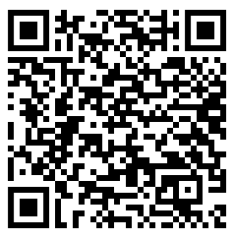

Was £6,000 Ex. VAT
Now £4,500 Ex. VAT
25% discount until 31/03/2024
Deal Extended!
Microsoft Copilot Readiness Pack
Ensure that your organisation is prepared to adopt AI securely and sustainably with Codestone’s Copilot Readiness Pack.
We can help you unlock significant productivity gains, as well as reducing administrative overhead, and promoting new levels of creativity. We will help you identify risks & benefits, and plan next steps in your Copilot adoption journey.
This pack includes:
1
Initial Workshop
2
Readiness Plan
Covers the benefits, risks, and requirements of adopting AI tools with key stakeholders at your organisation
Outlining the best next-steps for your organisation to ensure readiness and manage risk, highlighting business justifications
Copilot

Slide 2





The benefits: Copilot Readiness Package
Clarity
Risk Management
Benefits & Value
Business Planning
Next Steps
Helps you to understand all different types of Copilot, to identify which ones you need
Uncover hidden risks with this new technology, helping you to manage accordingly
Identifies the benefits of using Copilot, highlighting the value which it will bring to your organisation
Helps you formulate a prioritised plan, so you can budget for change
Codestone can help put these plans in to action as your trusted IT partner

