Slide 1
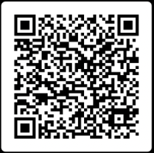
AI Workshop Starter Pack
Ensure that your organisation is prepared to adopt AI securely and effectively with Codestone’s 3-step Microsoft Copilot for 365 Workshop covering; From just £5,000
1
Copilot Fundamentals
Understand the main business objectives, identify key stakeholders, understand the current business challenges, identify immediate opportunities, and outline the steps required to become Copilot AI-ready – Copilot Demo
2
Art of the Possible
User awareness and education, provide them with the knowledge and tools to begin using Copilot in their everyday environment.​ Prompt Engineering; PoC definition, user profiling, and scheduling catch-ups with key stakeholders
3
Adoption Planning
Evaluate PoC, Define adoption plan to the wider organisation, identify mid/long term benefits & align best practise for Data Permission, Security and Governance
Microsoft 365 Copilot

